Slide 1
EMBEDDED SYSTEM DESIGN PROJECT
ESE-4009
Interfacing Beagle bone black with adafruit
Submitted by:-
Gurman Singh (C0753359)
EMBT 4th SEM

Slide 2
About the project
In a gesture keyboard in which words are typed in air, that are displayed in PC/laptop. The components used are Arduino board, Bluetooth module, Gyroscope and PC/laptop. The machine learning algorithm "Supervised learning" is used with some predictions along with designed project to detect the alphabet. The whole project or design is controlled by Beaglebone black. The project's main aim is to detect the letters by hand in air should be recognized and displayed on the PC/laptop. The gyroscope is attached to hand, so when letters are written in air, through Bluetooth module, the data is transferred to the laptop where they are displayed.

Slide 3
LIST OF HARDWARE COMPONENTS USED IN THE PROJECT ARE LISTED BELOW:
BeagleBone Black
Gyroscope sensor
Voltage regulator
LCD (16x2)
Wi-Fi Module
Lithium ion battery
Arduino UNO
RF 315/433 MHZ

Slide 4
Interfacing beaglebone black with wifi module
Hardware Components required for interfacing:
Wifi module esp8266
Beaglebone black
Two micro USB cables
Software used for this interfacing are:
Putty
Filezilla client
Geany

Slide 5
Beaglebone black
Beaglebone is compact, low-cost, open-source Linux computing platforms that can be used to build complex applications that interface high-level software and low-level electronic circuits.
Beaglebone Black Rev C is a development kit based on an AM335x processor which integrates an ARM Cortex™-A8 core operating at up to 1GHz and has abundant peripheral devices.
Processor: AM335x 1GHz ARM® Cortex-A8
512MB DDR3 RAM
4GB 8-bit eMMC on-board flash storage
3D graphics accelerator
NEON floating-point accelerator
2x PRU 32-bit microcontrollers

Slide 6
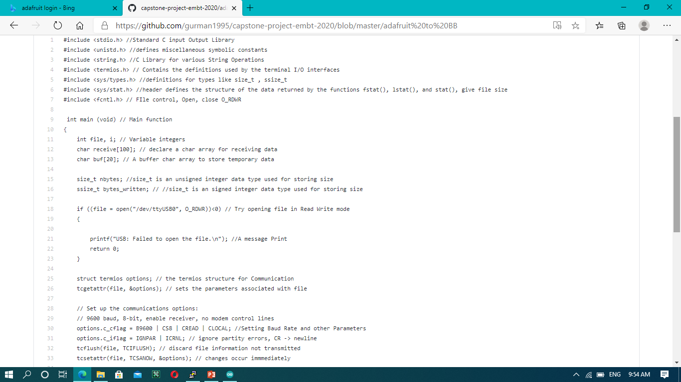

Slide 7
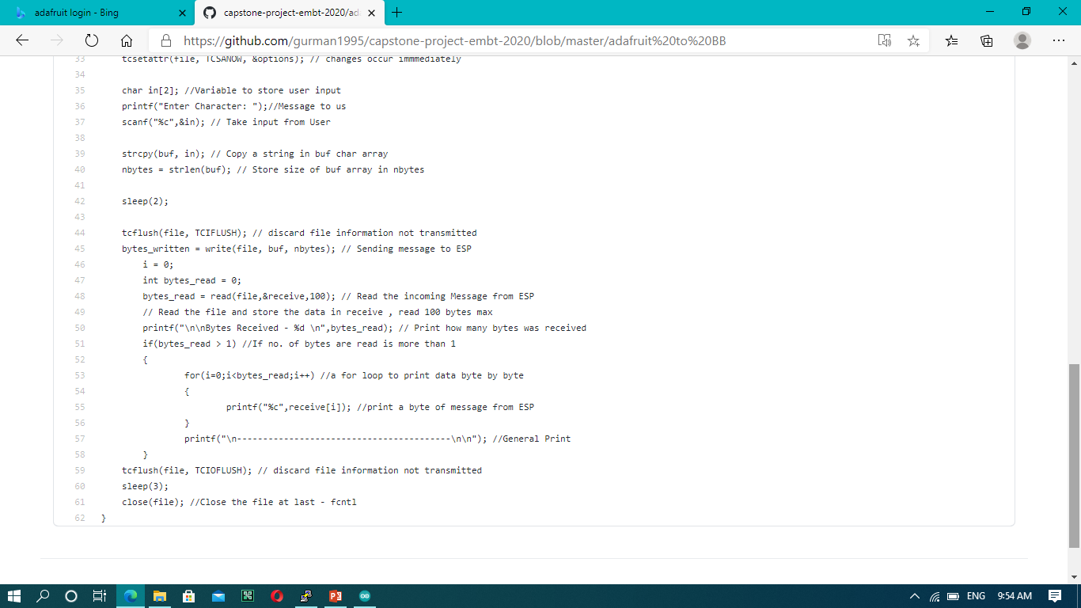

Slide 8
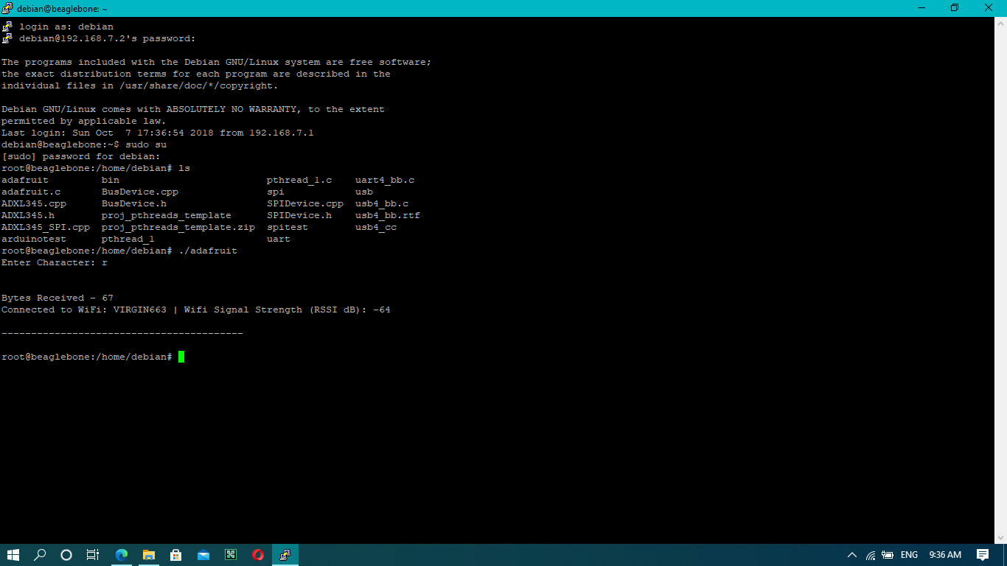

Slide 9
Wifi Module ESP8266
Low cost, compact and powerful Wi-Fi Module
Power Supply: +3.3V only
Current Consumption: 100mA
I/O Voltage: 3.6V (max)
I/O source current: 12mA (max)
Built-in low power 32-bit MCU @ 80MHz
512kB Flash Memory
Can be used as Station or Access Point or both combined
Supports Deep sleep (<10uA)
Supports serial communication hence compatible with many development platform like Arduino
Can be programmed using Arduino IDE or AT-commands

Slide 10
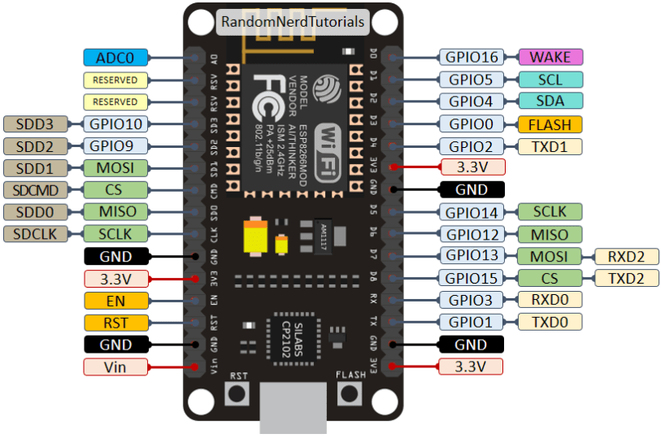

Slide 11
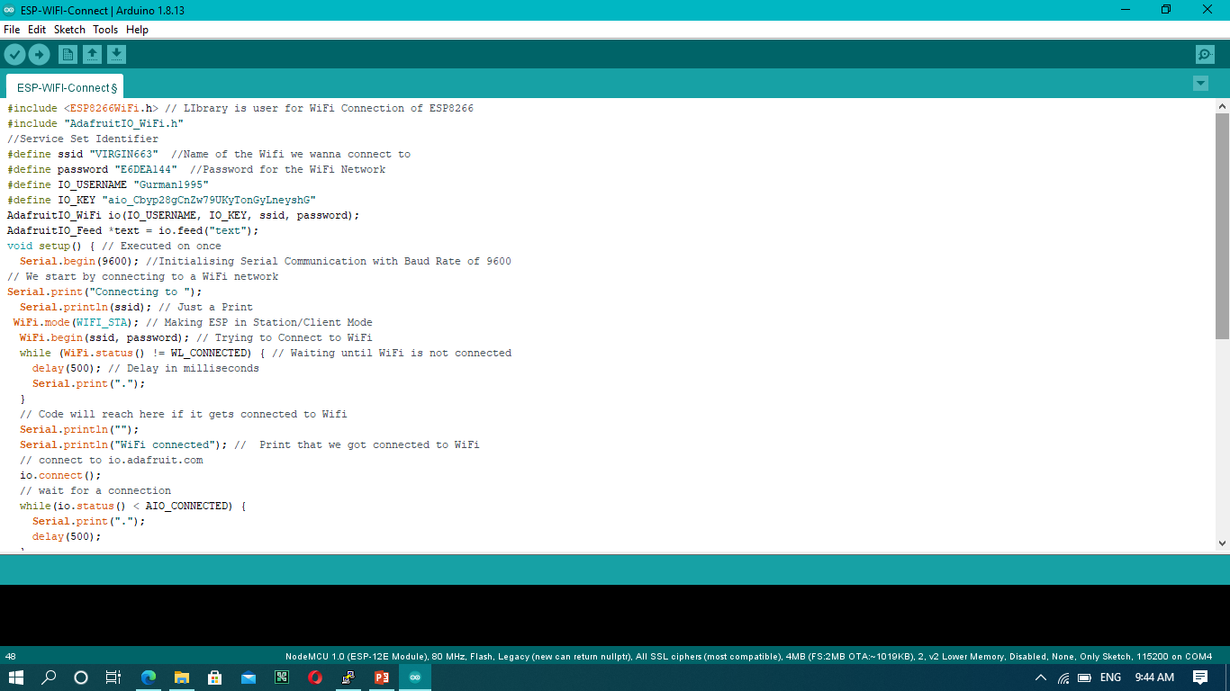

Slide 12
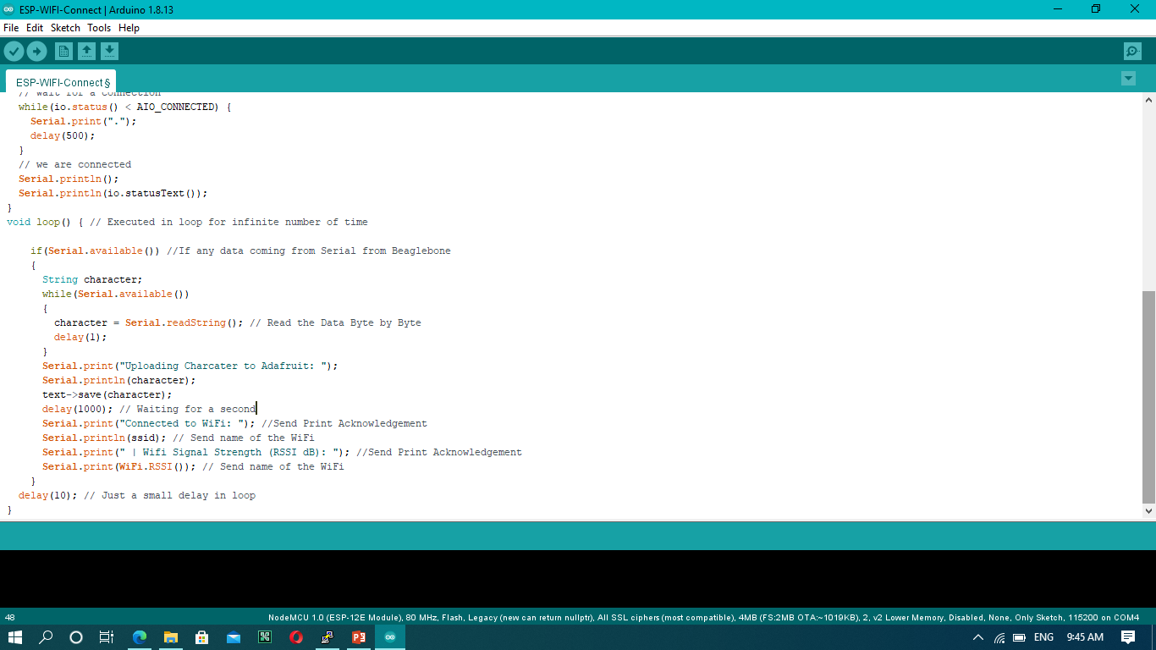

Slide 13
putty
PuTTY is an SSH and telnet client, developed originally by Simon Tatham for the Windows platform.
PuTTY is open source software that is available with source code and is developed and supported by a group of volunteers.
PuTTY was originally written for Microsoft Windows, but it has been ported to various other operating systems.
PuTTY comes bundled with command-line SCP and SFTP clients, called "pscp" and "psftp" respectively, and plink, a command-line connection tool, used for non-interactive sessions.

Slide 14
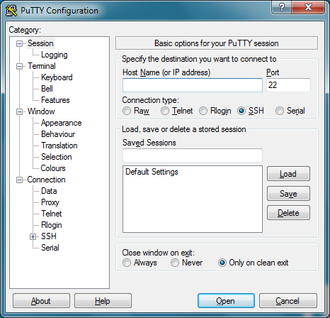

Slide 15
Filezilla client
Filezilla is a free and open source FTP client for windows, Mac etc. It is developed and maintained by Tim losse and the filezilla team.
Encryption of file transfers with secure FTP and FTP-SSL.
Manage files with cut and paste.
Easily connecting without a password using ssh keys.
Storing your passwords and site preferences in the site manager.
Bookmarking of local and remote folders for easy folder navigation.

Slide 16
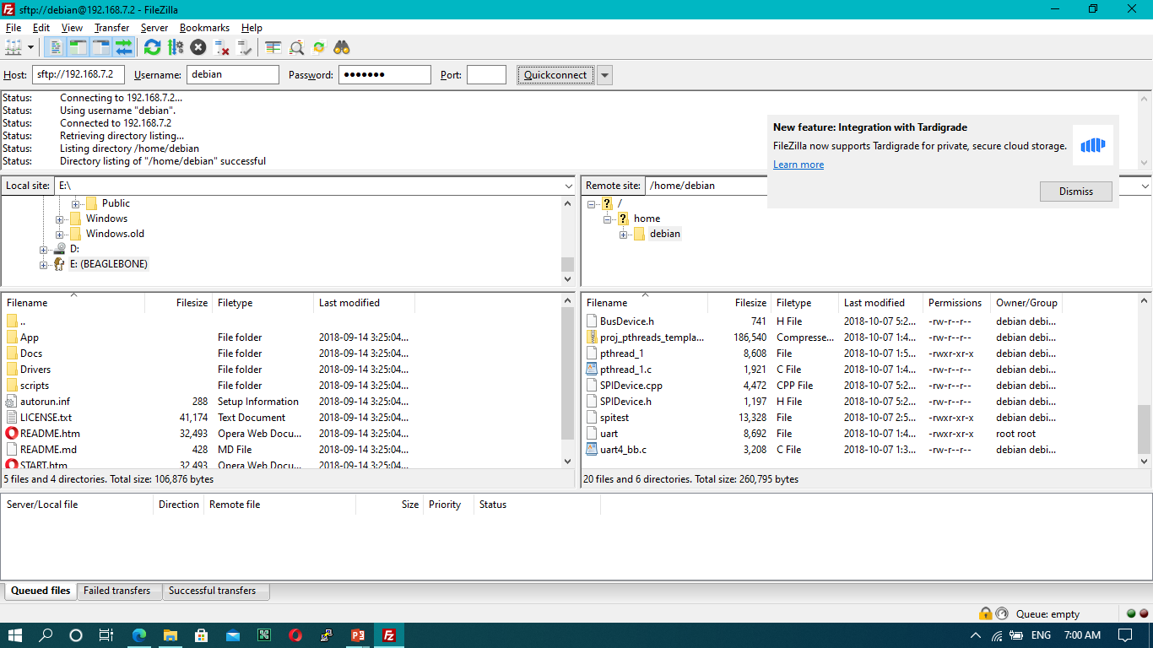

Slide 17
Geany
Geany is a small and lightweight Integrated Development Environment. It was developed to provide a small and fast IDE, which has only a few dependencies on other packages.
syntax highlighting
Code folding
Autocompletion of symbols/words
Construct completion/snippets
Auto-closing of XML and HTML tags
Calltips
Many supported filetypes including C, Java, PHP, HTML, Python, Perl, Pascal, and others
Symbol lists
Code navigation

Slide 18
Adafruit cloud
Adafruit.io is a cloud service - that just means we run it for you and you don't have to manage it. You can connect to it over the Internet. It's meant primarily for storing and then retrieving data but it can do a lot more than just that!
Display your data in real-time, online
Make your project internet-connected: Control motors, read sensor data, and more!
Connect projects to web services like Twitter, RSS feeds, weather services, etc.
Connect your project to other internet-enabled devices
The best part? All of the above is do-able for free with Adafruit IO

Slide 19
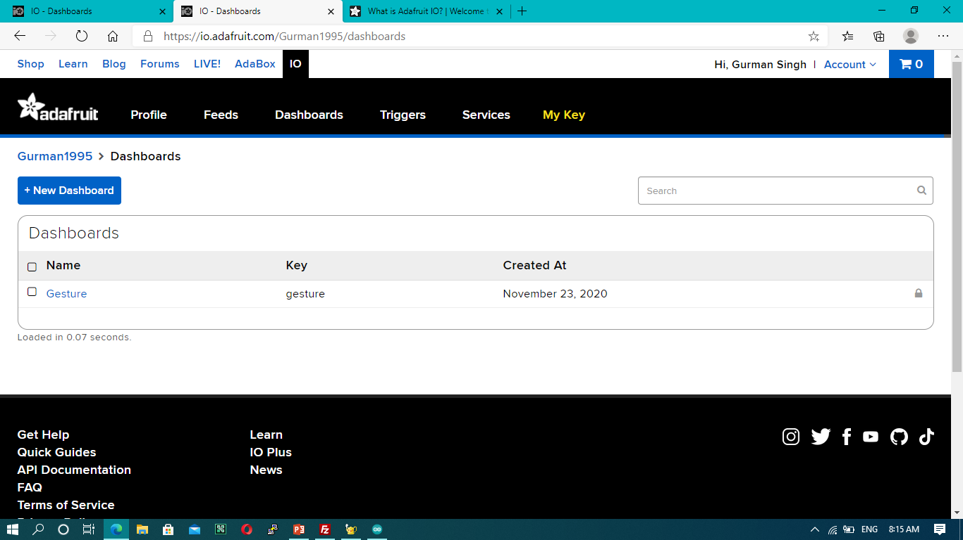

Slide 20
Working
In gesture keyboard project Beaglebone black is used as a master device.
Beaglebone black is used to get data from RF transmitter and receiver and display on LCD. Second function of master device to send the data to cloud(adafruit) with the help of wifi module esp8266.
Wifi module is used to connect wifi network with beaglebone black. To connect this, we need to put a code in esp 8266 chip and run in a Arduino IDE.
UART protocol is used to interface beaglebone black with wifi module esp8266.

Slide 21
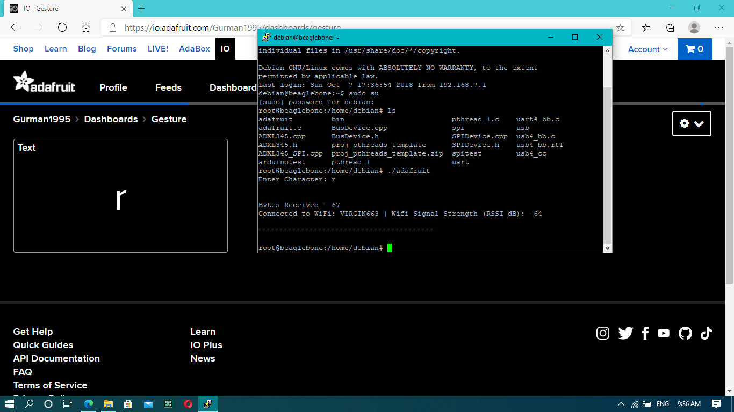
Final output

Slide 22
references
ESP8266 - WiFi Module. (n.d.). Retrieved November 08, 2020, from https://components101.com/wireless/esp8266-pinout-configuration-features-datasheet
Introduction to FileZilla. (n.d.). Retrieved November 08, 2020, from https://www.exavault.com/docs/ftp-clients/filezilla/00-introduction
By Trev, P. (2018, February 09). How to get UART serial ports working on the beaglebone black. Retrieved November 08, 2020,
Linux Serial Ports Using C/C++. (2020, September 27). Retrieved November 08, 2020, from https://blog.mbedded.ninja/programming/operating-systems/linux/linux-serial-ports-using-c-cpp/
BeagleBone Black Pinout, Pin Configuration, Features and applications. (2019, December 24). Retrieved November 08, 2020, from https://microcontrollerslab.com/beaglebone-black-pinout-pin-configuration-features-applications/

Slide 23
Thank You

